Slide 1


DATA VISUALIZATION FOR NASA’S EYE ON ASTEROID
8ISE1
ROLL NO NAME
20201ISB0005 Dhanusha.A
20201ISE0011 Shana.m
20201ISE0044 kavya.j
Ms. Poornima S Ast.Professor
School of Computer Science & Engineering
Presidency University

Slide 2
Abstract
This abstract presents an overview of NASA's comprehensive approach to tracking and studying asteroids. Utilizing advanced telescopes, space probes, and computational modeling, NASA continually monitors the trajectories and characteristics of NEOs, identifying potential threats to Earth and informing mitigation strategies. Moreover, "Eyes on Asteroids" facilitates groundbreaking research into the composition, structure, and origins of these objects, shedding light on the formation processes of our solar system.
Overall, NASA's "Eyes on Asteroids" initiative represents a multifaceted approach to unlocking the mysteries of our cosmic neighborhood while safeguarding our planet from potential threats. Through continued innovation and collaboration, this initiative promises to shape the future of space exploration and planetary defense for generations to come.

Slide 3
Introduction
Visualizing data from NASA's "Eyes on Asteroids" dataset helps us understand and explore information about asteroids. By using graphs, maps, and other visuals, we can see patterns, trends, and important details about these space rocks. It's like creating a picture of what's going on in space, making it easier for scientists and anyone interested to grasp the information and make discoveries.
By aggregating data from various sources, including ground-based telescopes, space probes, and astronomical surveys, NASA compiles an extensive dataset encompassing the orbital parameters, physical properties, and spatial distribution of asteroids.

Slide 4
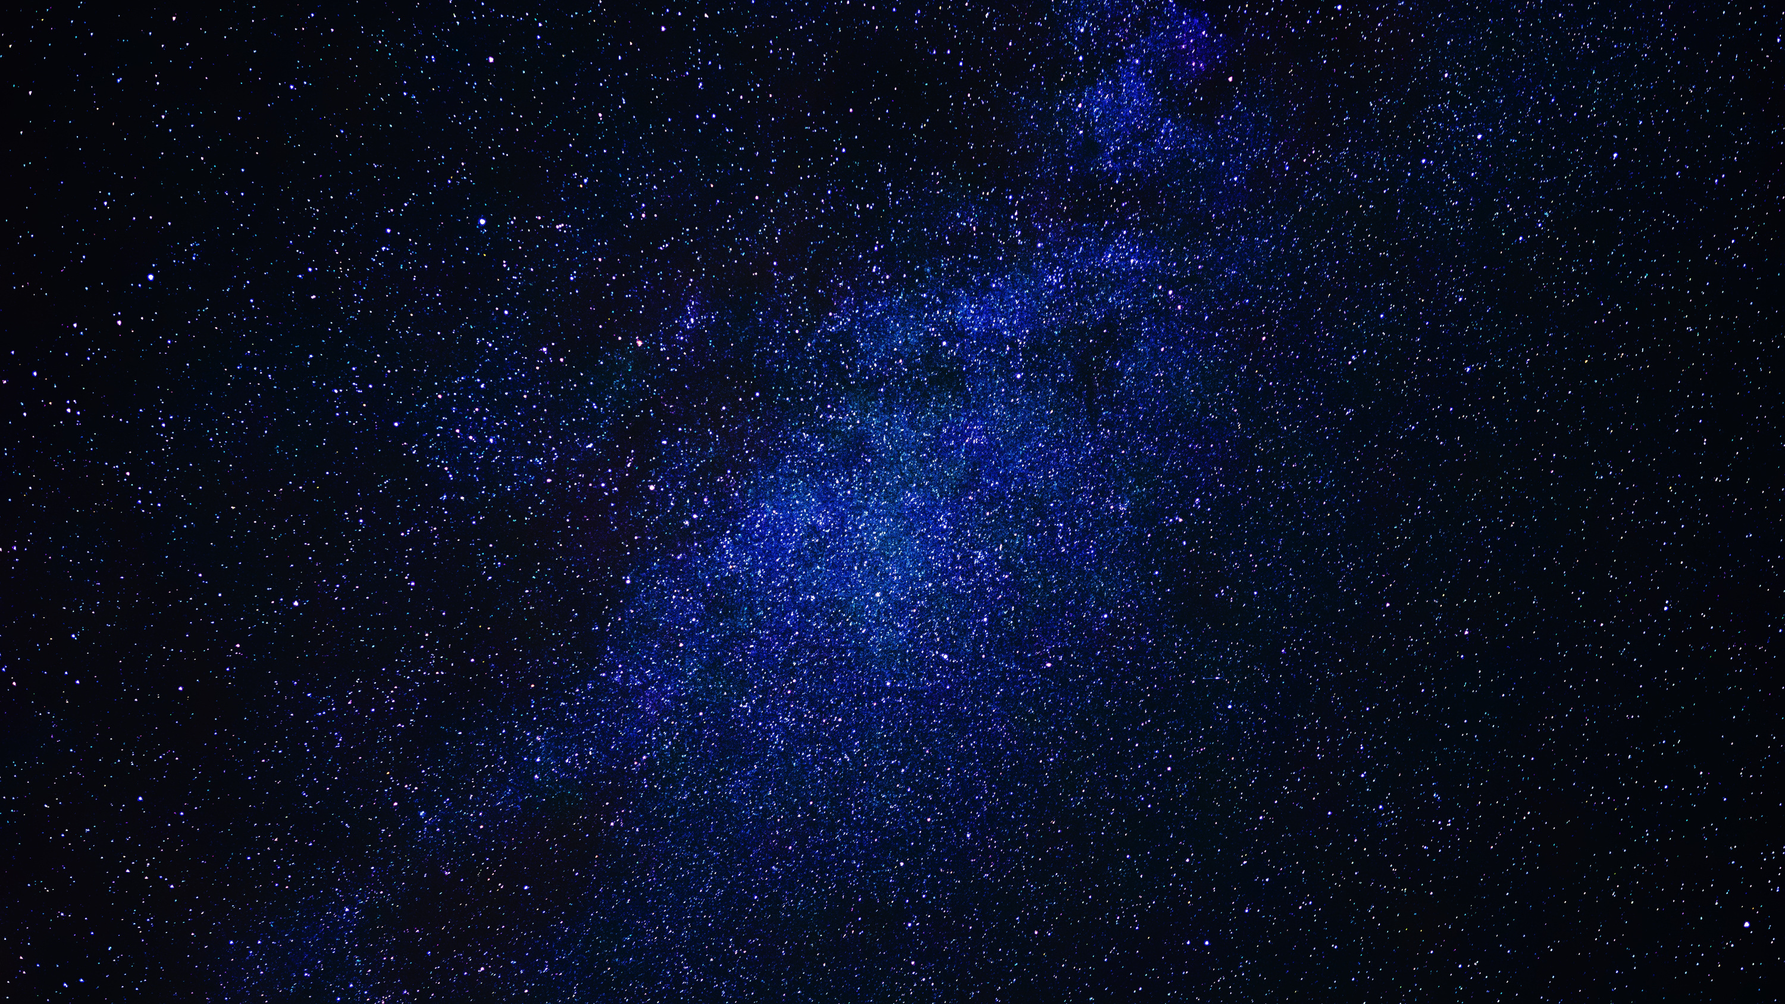
Advantages of existing method
NASA's "Eyes on Asteroids" initiative offers numerous advantages across various domains, ranging from scientific discovery to planetary defense and future space exploration endeavors. Here are some key advantages:
Early Detection of Potential Threats: By continuously monitoring the trajectories of Near-Earth Objects (NEOs) and identifying potentially hazardous asteroids, NASA's initiative enables early warning systems that can alert us to potential impacts on Earth. This early detection capability provides crucial time for mitigation efforts to be planned and executed, potentially averting catastrophic events.
Informing Planetary Defense Strategies: By studying the physical properties and orbits of asteroids, NASA can better inform and refine planetary defense strategies. This includes developing techniques for deflecting or mitigating the impact risk posed by potentially hazardous asteroids, safeguarding not only Earth but also future space missions.
Inspiration for Future Exploration: The exploration of asteroids captures the imagination of the public and inspires future generations of scientists, engineers, and explorers. By showcasing humanity's ability to explore and understand the cosmos, NASA's initiative fosters curiosity and innovation, driving advancements in technology and space exploration capabilities.

Slide 5
Disadvantage
While NASA's "Eyes on Asteroids" initiative offers numerous advantages, there are also some potential disadvantages and challenges associated with the endeavor:
Resource Constraints: Funding and resource constraints can limit the scope and scale of NASA's asteroid monitoring and exploration efforts. Budgetary limitations may restrict the deployment of additional telescopes or spacecraft, as well as the development of new technologies for asteroid detection and characterization.
Limited Coverage: Despite advancements in technology, there are still limitations in the coverage provided by current asteroid monitoring systems. Some regions of space may be difficult to observe due to factors such as orbital dynamics, celestial obstructions, or limitations of existing telescopes and instruments.
Public Perception and Fear: Heightened awareness of asteroid impacts could potentially lead to public anxiety or fear about the perceived threat posed by these celestial objects. Misinformation or sensationalized reporting of asteroid-related events could exacerbate these concerns and impact public perception of space exploration efforts.

Slide 6
Proposed methods
NASA's "Eyes on Asteroids" initiative employs a variety of methods and technologies to detect, track, and study asteroids. Here are some proposed methods used in the initiative:
Ground-Based Observations: NASA utilizes ground-based telescopes equipped with advanced imaging technologies to scan the night sky for asteroids. These telescopes can detect asteroids through optical and infrared observations, providing valuable data on their positions, trajectories, and physical characteristics.
Spacecraft Missions: NASA sends spacecraft missions to study asteroids up close, providing detailed insights into their composition, structure, and origins. Missions like OSIRIS-REx and Hayabusa2 collect samples from asteroids, while others, like NEAR Shoemaker and Dawn, conduct in-depth investigations from orbit.
Collaborative Networks: NASA collaborates with international space agencies, observatories, and research institutions to enhance asteroid monitoring capabilities. Sharing data, resources, and expertise facilitates a global network of astronomers and scientists working together to track and study asteroids.

Slide 7
Architecture
1.Data Collection: We gather data from reliable sources like GitHub, kaggle and other repositories. This repository provides comprehensive datasets on NASA eye on asteroids. Additionally, we may incorporate data from other reputable sources to supplement our analysis.
2.Data Preprocessing: Before conducting analysis, we preprocess the raw data to ensure consistency, accuracy, and usability. This involves tasks such as handling missing values, We also perform data cleaning and validation to identify and correct any anomalies or discrepancies in the dataset.
1.Exploratory Data Analysis (EDA): We conduct exploratory data analysis to gain an initial understanding of the dataset and identify potential trends, patterns, and outliers. This involves descriptive statistics, data visualization, and hypothesis testing to uncover insights and formulate research questions for further analysis.

Slide 8
Architecture
4 . Descriptive Analysis: We perform descriptive analysis to summarize the key characteristics of the asteroids, including name, if it is hazardous or not , and their characteristics. This helps provide context and a baseline understanding of the asteroids impact on earth.
5.Temporal Analysis: We conducttime-series analysis to examine the temporal dynamics of NASA eye on Asteroids. This involves visualizing trends, fluctuations, and seasonality in the data using line charts, bar charts, and other time- series visualizations. We may also apply statistical techniques such as moving averages and exponential smoothing to smooth the data and identify underlying trends.
6.Comparative Analysis: We perform comparative analysis to understand if the asteroid is potentially hazardous or not.

Slide 9
Architecture
7. .Advanced Visualization Techniques: We utilize advanced data visualization techniques such as bar chart races, treemaps, and word clouds to create dynamic and interactive visualizations of the NASA eye on asteroids data.
8.Statistical Modeling (if applicable): Depending on the research questions and objectives, we may employ statistical modeling techniques such as regression analysis, time-series forecasting, or machine learning algorithms to identify underlying patterns, make predictions, or test hypotheses related to the pandemic.
9.Interpretation and Reporting: Finally, we interpret the findings from our analysis and summarize them in a comprehensive report or presentation. We communicate key insights, trends, and implications to stakeholders, policymakers, and the general public to inform decision-making and response efforts.

Slide 10

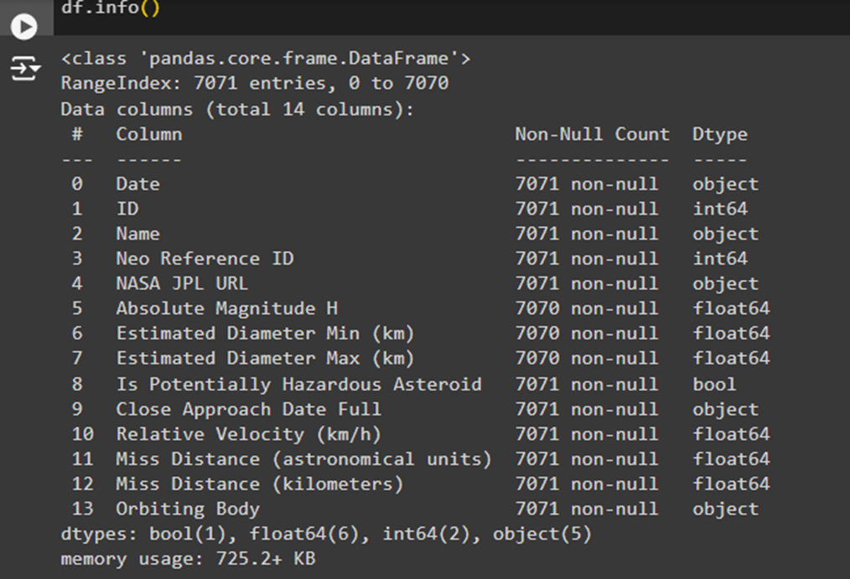
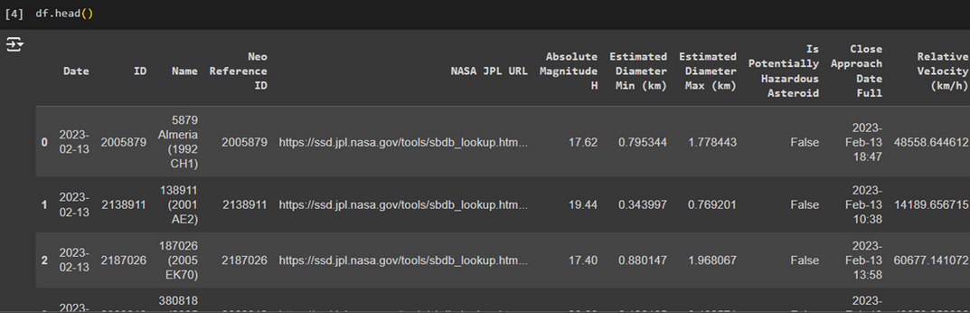
Results:

Slide 11
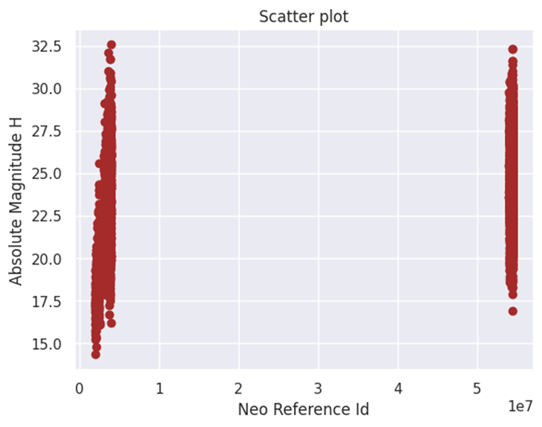
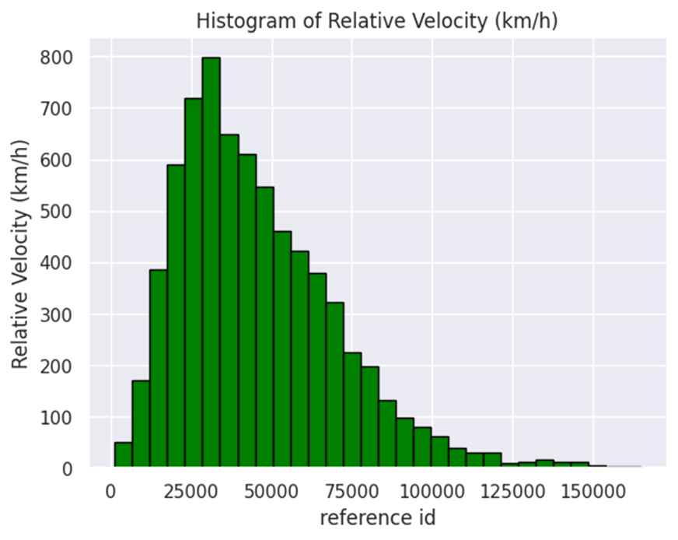
Results:

Slide 12
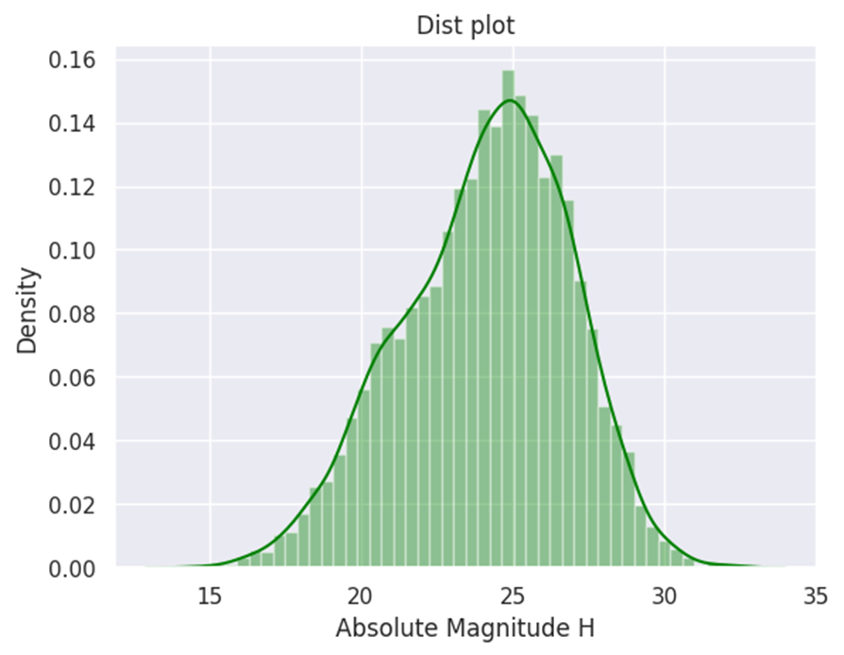
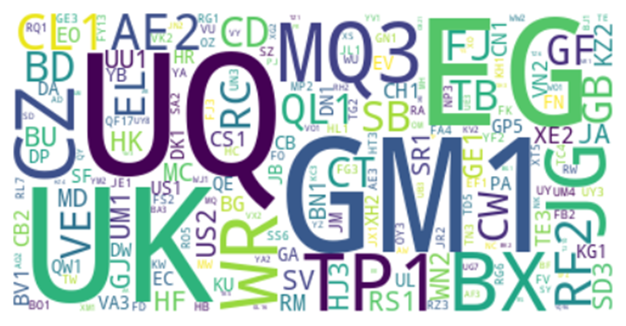
Results:

Slide 13
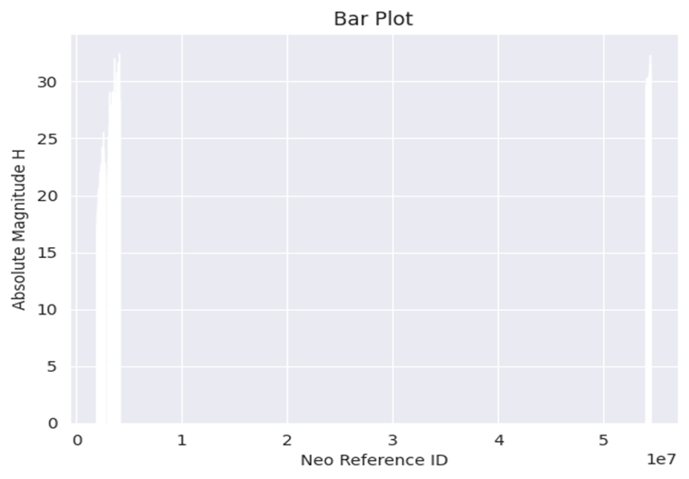
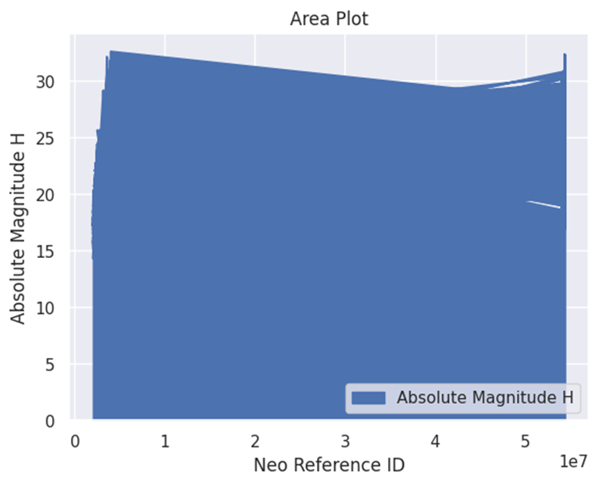
Results:

Slide 14
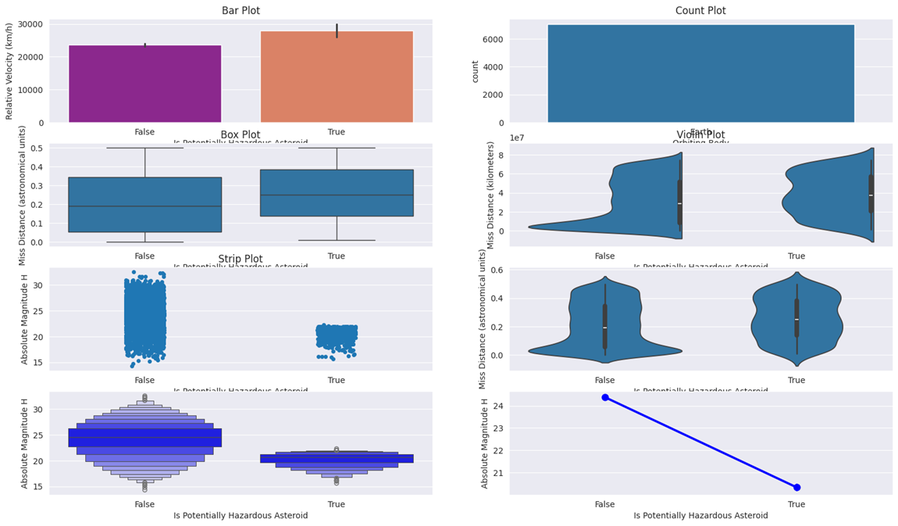
Results:

Slide 15
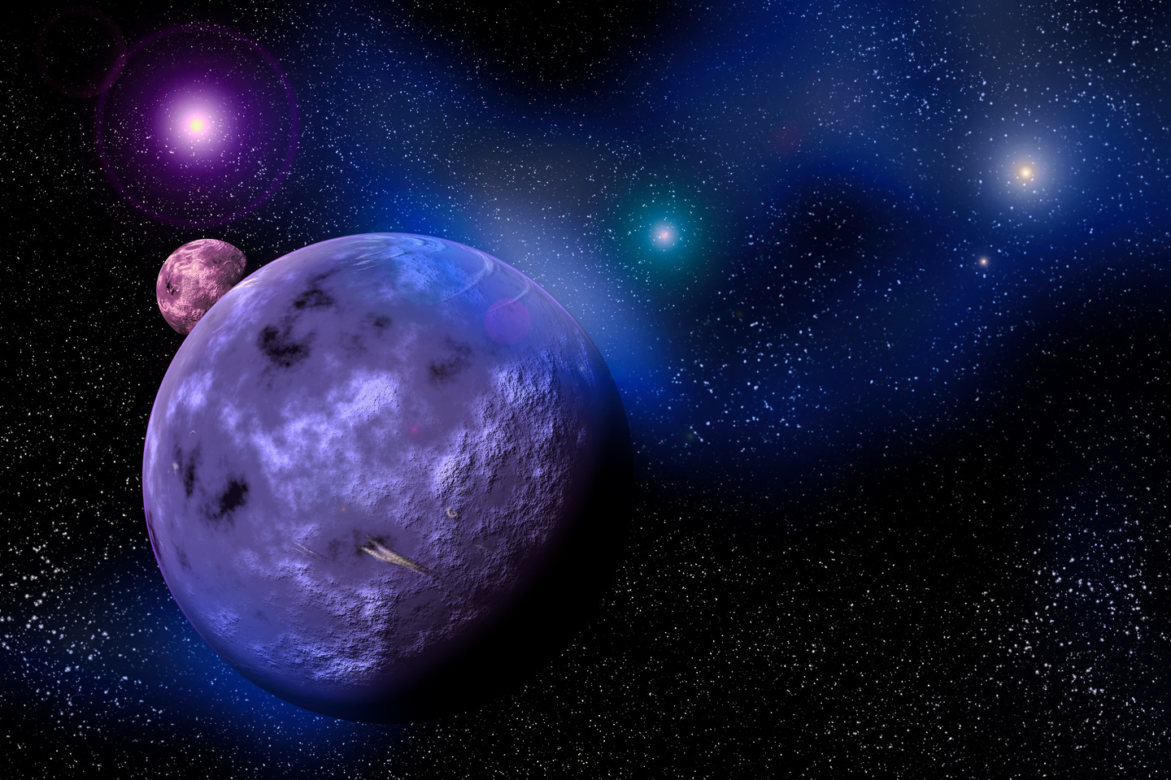
Conclusion
In conclusion, the data visualization of NASA's "Eye on Asteroids" dataset offers valuable insights into the characteristics and distribution of asteroids near Earth. By employing various visualization techniques such as scatter plots, histograms, and heatmaps, we were able to analyze important parameters such as asteroid size, velocity, and orbital characteristics.

Slide 16
Thank you very much!

